Slide 1
AnaLYZING Datasets with k-means algorithm
By Christopher Tam, Ryan Berry, Jeremy Falstein

Slide 2
Table of Contents
Introduction
What is K-means algorithm? – Brief Overview
How does it work?
Brief Representation -
So what kind of dataset do we need?
Diabetes 130-US hospitals for years 1999-2008 Data Set
How are we using K-means algorithm on this data set?
Implementation (Pseudo code)
Conclusion – What did we learn from this?
References

Slide 3
IntroDuction
Christopher Tam – Computer Science Senior
Aspiring Web App Developer,
Jeremy Falstein – Computer Science Senior
Aspiring Mobile App Developer,
Ryan Berry – Computer Science Junior
Aspiring Cool Guy
Our project was to conduct an experiment by designing a MapReduce-based machine learning algorithm.
The three of us have compromised with the algorithm we wanted to work on: k-means, and the correlating data-set we were planning to use for this project.

Slide 4
So What is K-means?
According to various sources, k-means clustering is an unsupervised machine learning approach, and clustering algorithm.
It’s one of the most popular, or widely used clustering algorithms in the world of big data.
What we want k-means to do is to automatically group data into logical subsets, or clusters.

Slide 5
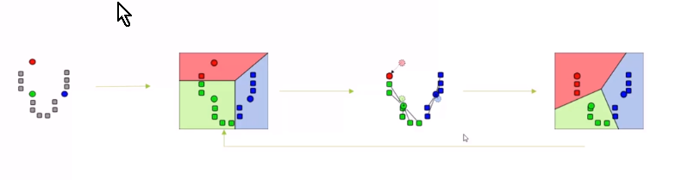
Brief Representation

Slide 6
So what can we use k-means for?
We can use k-means to discover interesting types of groupings within people/ behavior/ etc.
E.g. – Where do millionaires live?
Income distribution – how much of the population makes less than 50,000?

Slide 7
So what kind of dataset would we need to do k-means?
It highly recommended that one should find a dataset with numerical attributes rather than nominal data.
You can also represent nominal data as a numeric value if it is abundant in classifications. E.g- Age groups 1-5, 5-10, 10-15, etc…

Slide 8
The dataset we used
We used a subset of a dataset conducted by professors at Virginia Commonwealth University, which collected data from hospitals over the years 1999-2008. the data set covers information about diabetes patients who were hospitalized due to their condition.
The part of the data that we are using includes the number of procedures the patient underwent and the number of medications that they had administered during their stay. We hope to use this data to find some correlation between the number of procedures and the amount of medication they ultimately received.

Slide 9
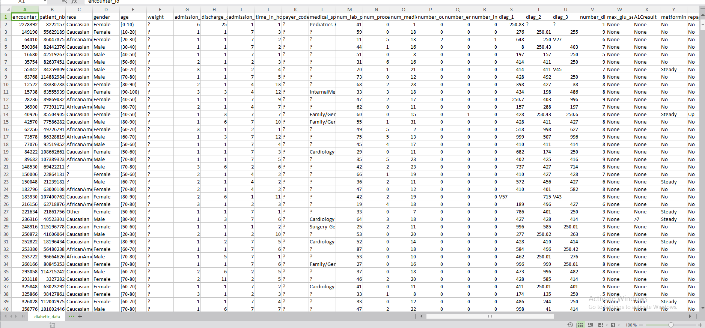

Slide 10
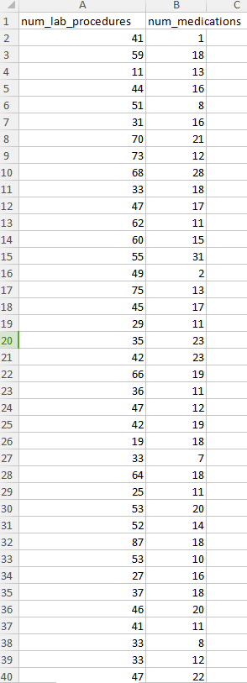

Slide 11
Using k-mEans clustering
We figured that we can turn the number of lab procedures, and the number of medications into a data point that would be used for the algorithm to create clusters.
Given those data points, we can determine the initial centroid values, cluster them based on range and update them thoroughly until the centroids have stopped moving significantly (which means that program has converged).

Slide 12
PseudoCode
Kmeans file - the main file that does k-means
CentroidSelector file
The selector selects the centroids based on the graph and number of clusters
CentroidUpdater file
The updater calculates the average of all of the points in the cluster to set the next position of the centroid

Slide 13
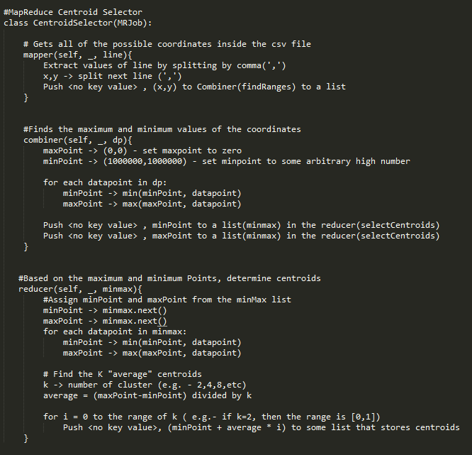

Slide 14
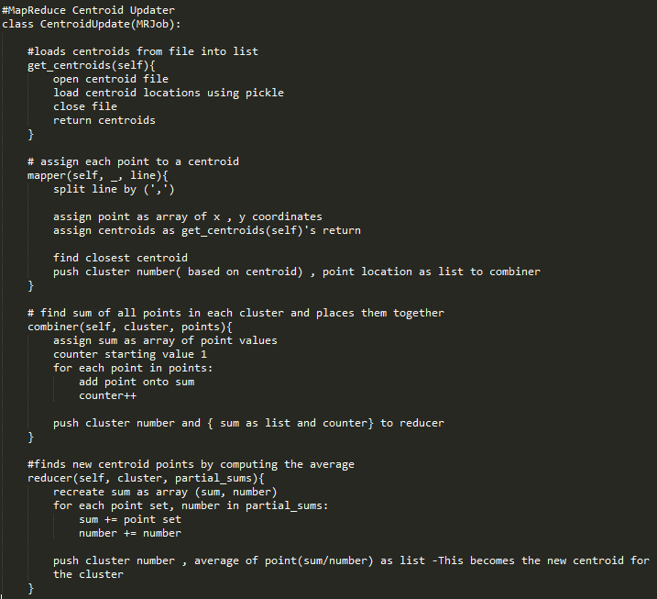

Slide 15
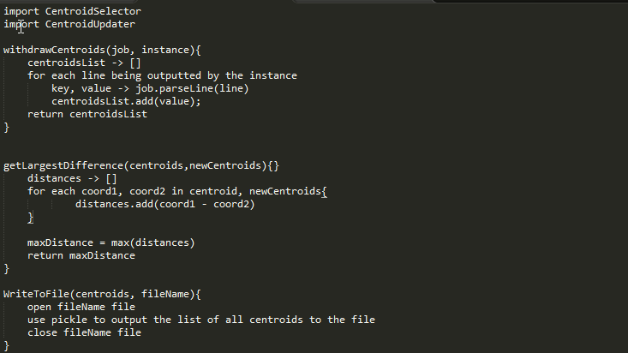
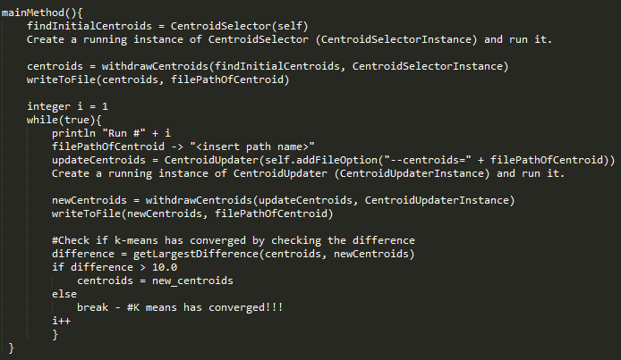

Slide 16
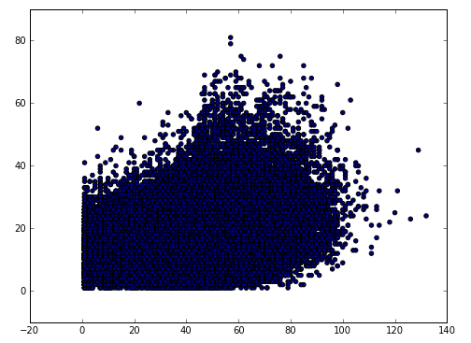
all points plotted on graph

Slide 17
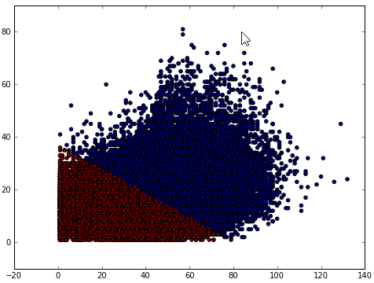
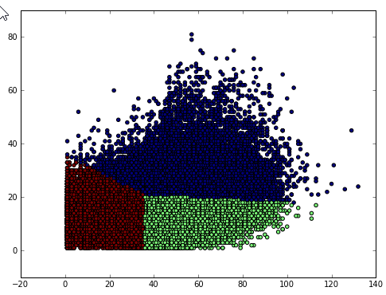
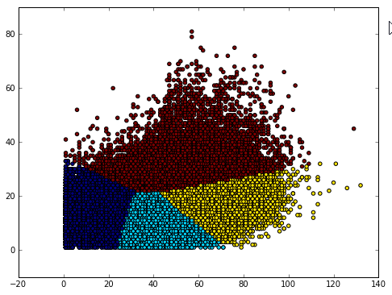
how it should look
numClusters = 2
numClusters = 3 numClusters=4

Slide 18
Our goal for this project

Slide 19
References
Frank Kane,Udemy(Taming Big Data with MapReduce and Hadoop),
Frank Kane,Udemy(Data Science and Machine Learning with Python),
Borja Sotomayor, 2013: https://github.com/uchicago- cs/cmsc12300/tree/master/examples/data_analysis/src/cs123/mrjob
Beata Strack, Jonathan P. DeShazo, Chris Gennings, Juan L. Olmo, Sebastian Ventura, Krzysztof J. Cios, and John N. Clore, “Impact of HbA1c Measurement on Hospital Readmission Rates: Analysis of 70,000 Clinical Database Patient Records,” BioMed Research International, vol. 2014, Article ID 781670, 11 pages, 2014.

